Slide 1

Product comparisons from AMD, Intel, and Nvidia
By truett bloxsom

Slide 2
Road map
Data Sources
Data Preprocessing
Frequency Analysis
Product Lift Analysis
MDS plot and Insights

Slide 3

Data sources
Over 3,300 posts from HardForum were scraped using Chrome web scraper extension
These posts came from 4 main threads: Intel CPUs, AMD CPUs, AMD GPUs, and NVIDEA GPUs
HardForum is a gaming centered forum
All Post were from the past 6 months

Slide 4
Data Preprocessing
Many of the rows were replies which included the original post being replied to, so these duplicates had to be removed
Forum users used many different names for the same product, so I had to replace many variants of the same product with one name
Normal NLP processing steps included: converting all words to lower case, tokenization, lamentation, removing stop words, and removing punctation

Slide 5
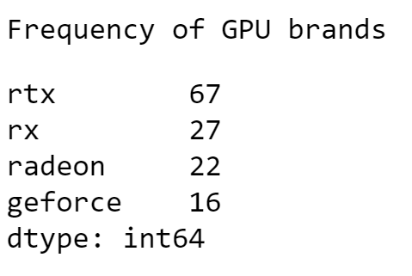
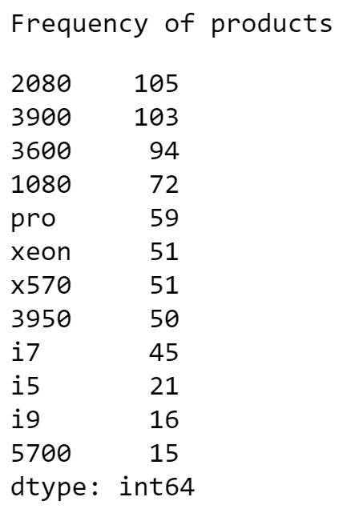
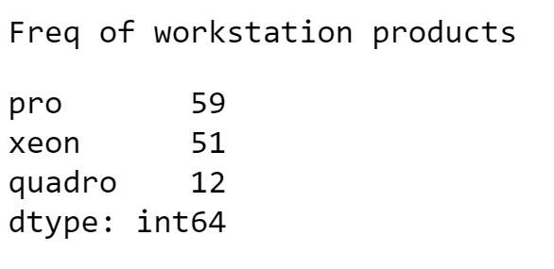
Frequency Analysis
Intel CPUs are not discussed as much as AMD CPUs
NVIDEA GPUs and their brand names are talked about much more than AMD GPUs and brand names
Intel and AMD workstation products are discussed more than NVIDIA

Slide 6
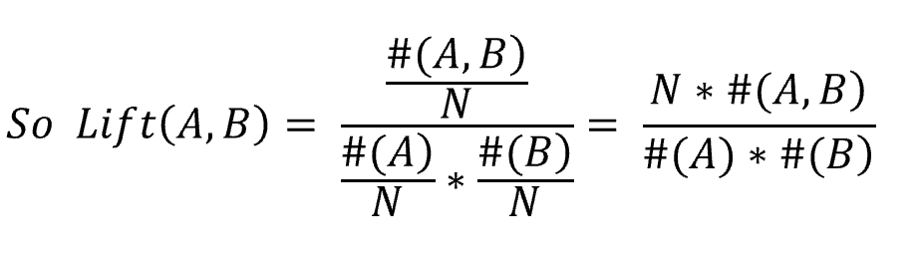
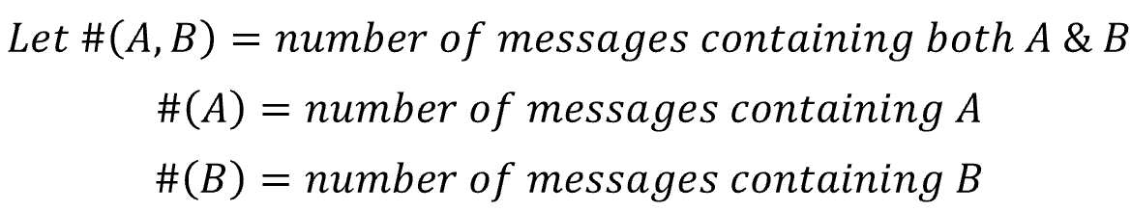
Lift (association) analysis between products
Lift > 1 means there is an association between the two products
Lift > 10 means the two products are synonymous
Lift = 1 means there is no association between the two products

Slide 7
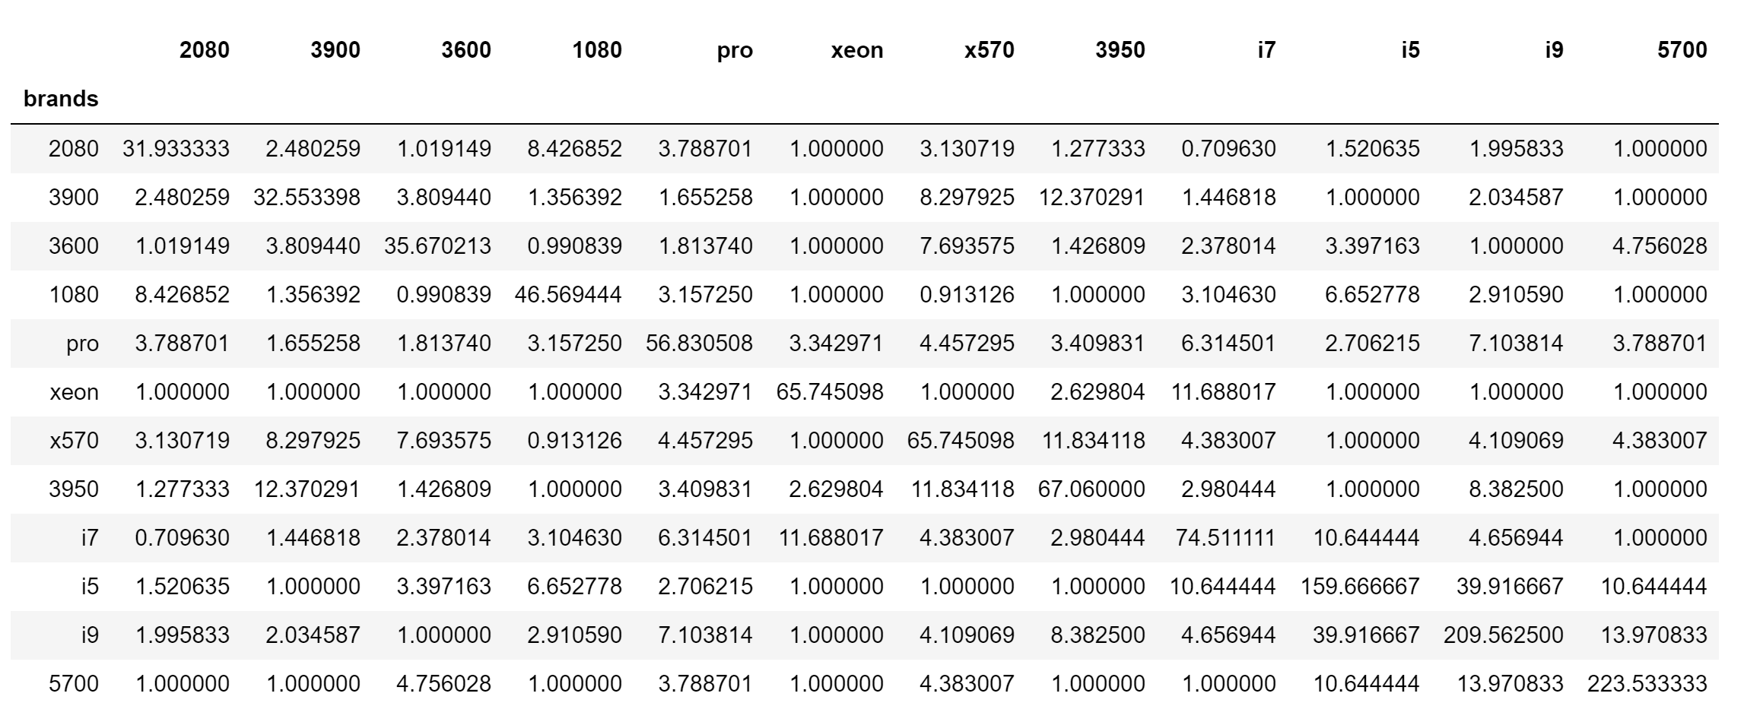
Lift of products matrix

Slide 8
MDS plot to the rescue
Multidimensional scaling (MDS) is a popular approach for graphically representing relationships between objects (i.e. brands or products) in multidimensional space.
01
Dimension reduction via MDS is achieved by taking the set of inverse product lifts and calculating a dissimilarity (distance) measure for each pairwise comparison of products.
02
The products are then represented graphically in two dimensions such that the distance between points on the plot approximates their multivariate dissimilarity as closely as possible.
03

Slide 9
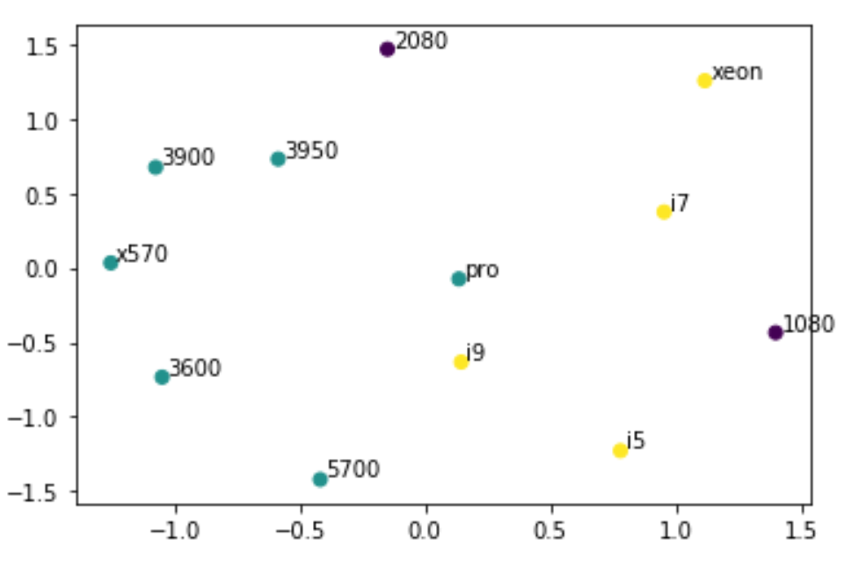
MDS plot and Insights
The older 1080ti is compared to Intel CPU's much more than AMD CPU’s
The newer 2080ti, the future of gaming, is slightly more compared with AMD CPU's than Intel

